Slide 1

Computer Networks
Introduction to data communication & Computer networks

Slide 2
About Me
Mashal Khan
BS Computer Systems Engineering (UET Peshawar)
MS Information Security (NUST Islamabad)
Email: mashal.khan@nu.edu.pk

Slide 3
Books and Relevant Content
Data communications and networking by Behrouz A. Forouzan
Data and Computer Communications by William Stallings
Computer Networking: A Top-Down Approach Featuring the Internet by Kurose and Ross, Sixth Edition
Software Defined Networks
Reading materials and Articles
Reference Slide at the end of every lecture to make your life easier ☺

Slide 4
Evaluations
Assessment | Weightage (%age)
Assignments / Case Studies | 10
Quizzes | 10
Project | 10
Sessional 1 | 15
Sessional 2 | 15
Finals | 40

Slide 5
Introduction
What is Internet?
What is networks?
Its importance
Major areas of Application
Industry Application/usage
Softwares used
Major Research Areas.
Notes:
Hype words in the field of networks
SDN , 5G etc, Optic fibre , IoT, Blockchain,

Slide 6
Data Communication
Networks exist so that data may be sent from one place to another.
Telecommunication network that allows computers to exchange data.
Connection between the exchanging devices can be wired or wireless.
Best known Computer network is Internet.
Notes:
In general refers to group of people sharing information among themselves. E.g. Alumni network, Social network etc. Similary used in computer world .

Slide 7
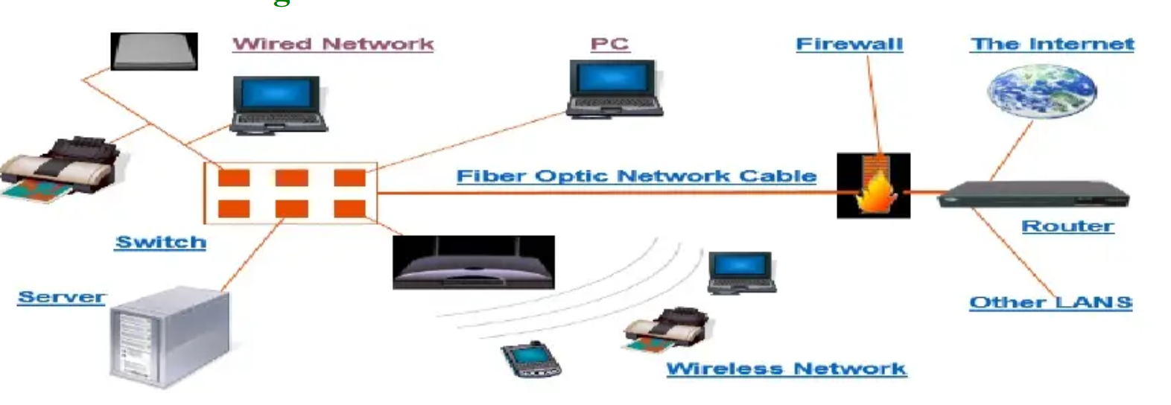
A system containing any combination of computers, computer terminals, printers, audio or visual display devices, or telephones interconnected by telecommunication equipment or cables: used to transmit or receive information.

Slide 8
Data Communication
When we communicate we share information
Local Communication, if Face to Face
Remote (tele), if through Telephone, Telex, television etc
Data
Information presented in any form that is agreed upon by communicating parties.
Text, Image, Video, Audio
Notes:
Networking in events, Exchange of useful information

Slide 9
Exchange of data between two devices via some form of transmission medium such as a wire or wireless
Data Communication is the exchange of information from One entity to another using a transmission medium
Keywords
Exchange
Information
Entity
Transmission medium

Slide 10
Internet
How it works?
Principals and Structure
Large number of users and devices
Nuts and bolts of internet(Hardware & Software elements involved)
Internet in terms of networking infrastructure
Provide services to the distributed applications

Slide 11
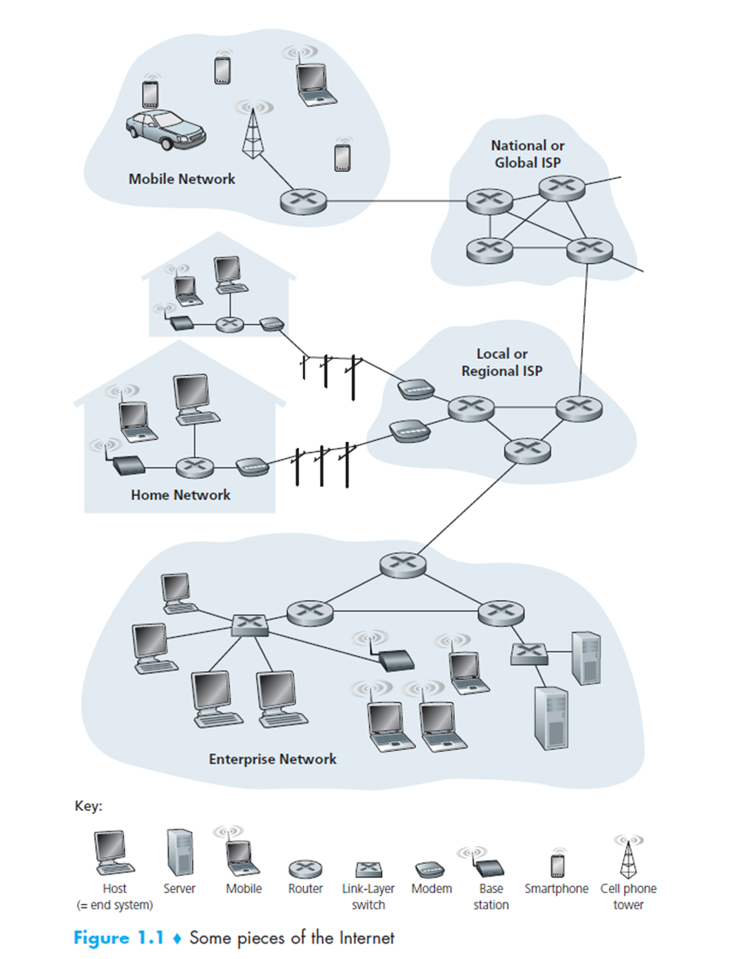
Nuts and Bolts of Internet
End Devices
Communication Links
Packets
Packet Switches

Slide 12
End Devices
laptops, smartphones, tablets, TVs, gaming consoles, Web cams, automobiles, environmental sensing devices,picture frames, and home electrical and security systems are being connected to the Internet
More than 2 billion internet users

Slide 13
Communication Links
End systems are connected by a network of communication links and packet switches.
Many types of physical media are used for communication
Coaxial Cable
Twisted Pair
Copper Wire
Optical Fiber
Radio Spectrum
Different links can transmit data at different rates, with the transmission rate of a link measured in bits/second.

Slide 14
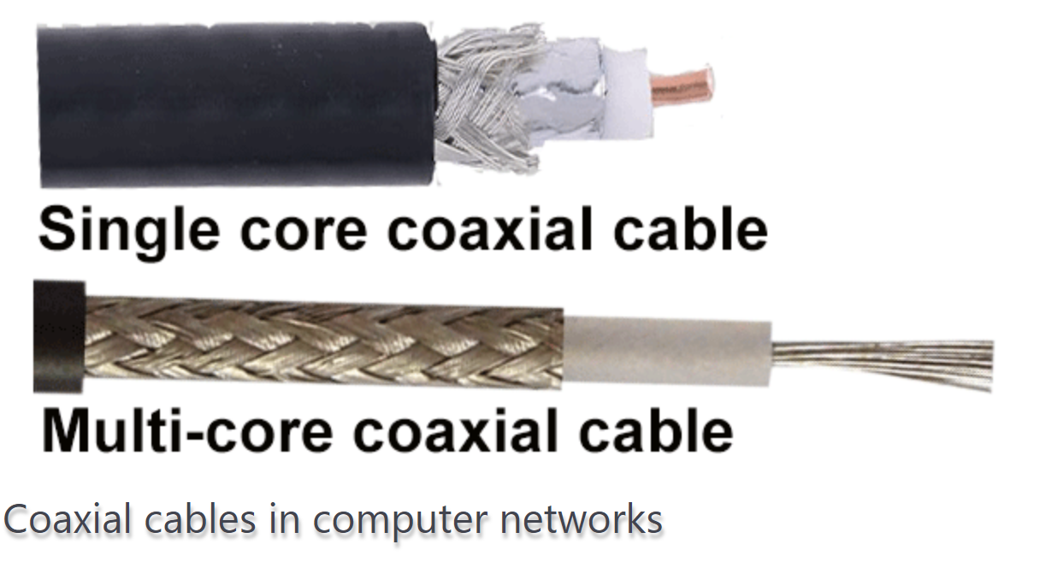
Notes:
Because of its low cost and long durability, coaxial cables were used in computer networking for nearly two decades (the 80s and 90s). Coaxial cables are no longer used to build any type of computer network.

Slide 15
Twisted Pair
The twisted-pair cable was primarily developed for computer networks. This cable is also known as Ethernet cable. Almost all modern LAN computer networks use this cable.
This cable consists of color-coded pairs of insulated copper wires. Every two wires are twisted around each other to form pair. Usually, there are four pairs. Each pair has one solid color and one stripped color wire. Solid colors are blue, brown, green, and orange. In stripped color, the solid color is mixed with the white color.
Based on how pairs are stripped in the plastic sheath, there are two types of twisted-pair cable; UTP and STP.

Slide 16
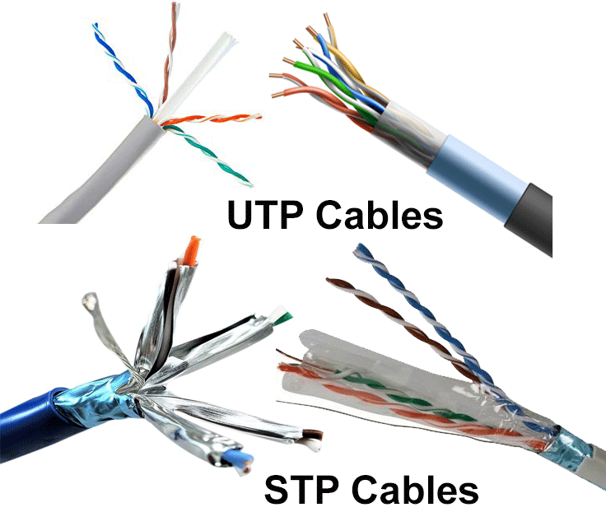

Slide 17
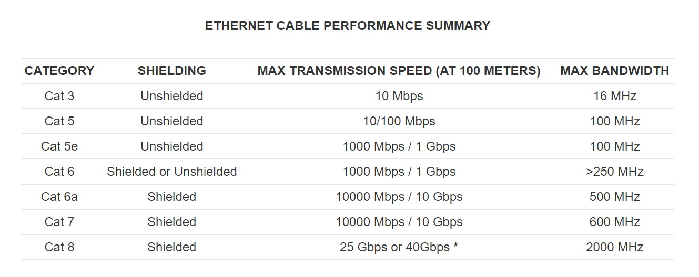

Slide 18
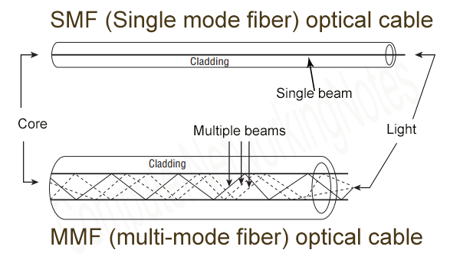
Optical Fiber Cable
This cable consists of a core, cladding, buffer, and jacket. The core is made from thin strands of glass or plastic that can carry data over a long distance. The core is wrapped in the cladding; the cladding is wrapped in the buffer, and the buffer is wrapped in the jacket.

Slide 19
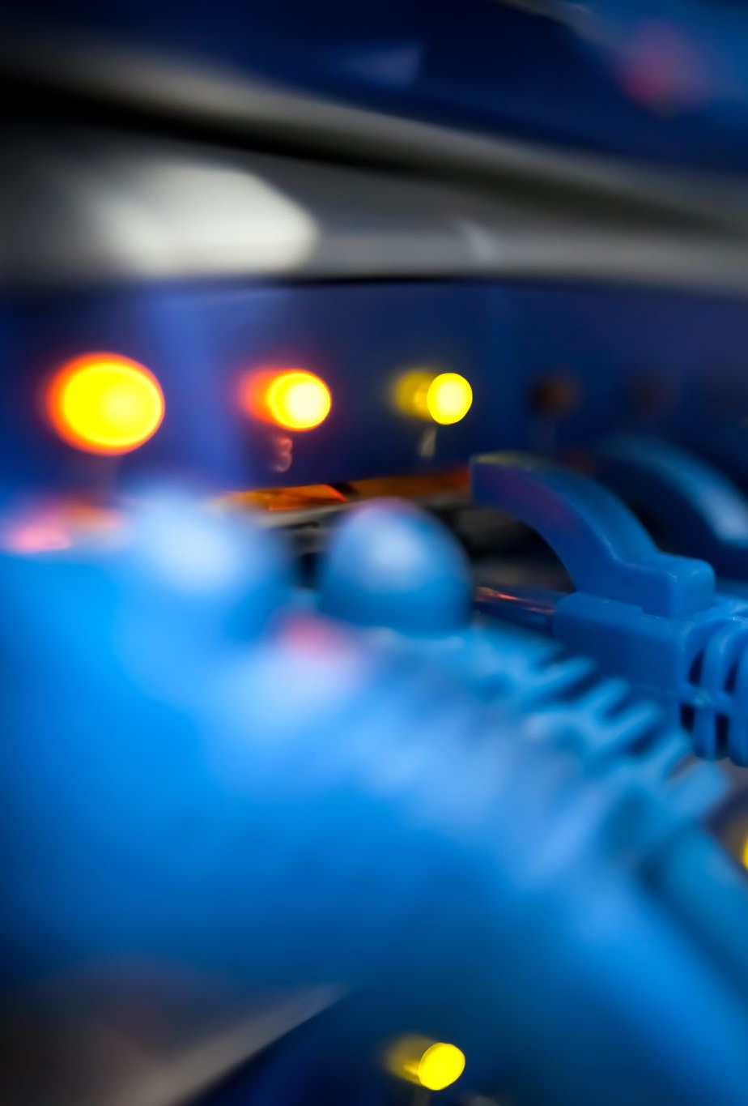
Packets and Packet Switches
Data to be transmitted and Headers called Packets
Various types of Packet Switches
Router
Hubs
Link Layer Switches
Packet switches facilitate the exchange of data among end systems
Notes:
Cargo example

Slide 20

ISPs
Internet Service Providers
Types
Residential(Local Cable and Telephone Companies)
Corporate (University, Enterprise etc)
The Internet is all about connecting end systems to each other, so the ISPs that provide access to end systems must also be interconnected.
These lower-tier ISPs are interconnected through national and international upper-tier ISPs such as Level 3 Communications, AT&T, Sprint, and NTT.
An upper-tier ISP consists of high-speed routers interconnected with high-speed fiber-optic links.
Each ISP network, whether upper-tier or lower-tier, is managed independently, runs the IP protocol and conforms to certain naming and address conventions.

Slide 21
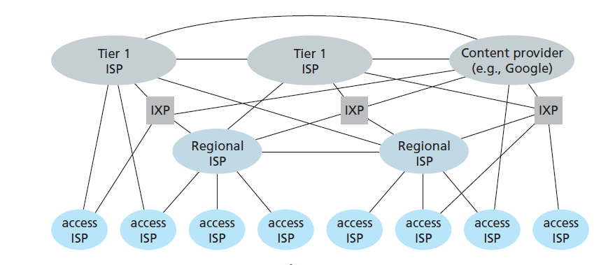

Slide 22
Components
Five basic Components of data communication
Message
Sender
Reciever
Transmission medium
Protocol

Slide 23
Message: The message is the information (data) to be communicated.
Sender/ Receiver: The sender/receiver is the device that sends/receives the data message.
Transmission medium: The transmission medium is the physical path by which a message travels from sender to receiver.
Protocol: A protocol is a set of rules that govern data communications.
Notes:
Example of telephone, LAN Messanger
Message: The message is the information (data) to be communicated. Popular forms of information include text, numbers, pictures, audio, and video.
Sender/ Receiver: The sender/receiver is the device that sends/receives the data message. It can be a computer, workstation, telephone handset, video camera, and so on.
Transmission medium: The transmission medium is the physical path by which a message travels from sender to receiver. Such as twisted-pair wire, coaxial cable, fiber-optic cable, and radio waves.
Protocol. A protocol is a set of rules that govern data communications. It represents an agreement between the communicating devices. Without a protocol, two devices may be connected but not communicating, just as a person speaking French cannot be understood by a person who speaks only Japanese.

Slide 24
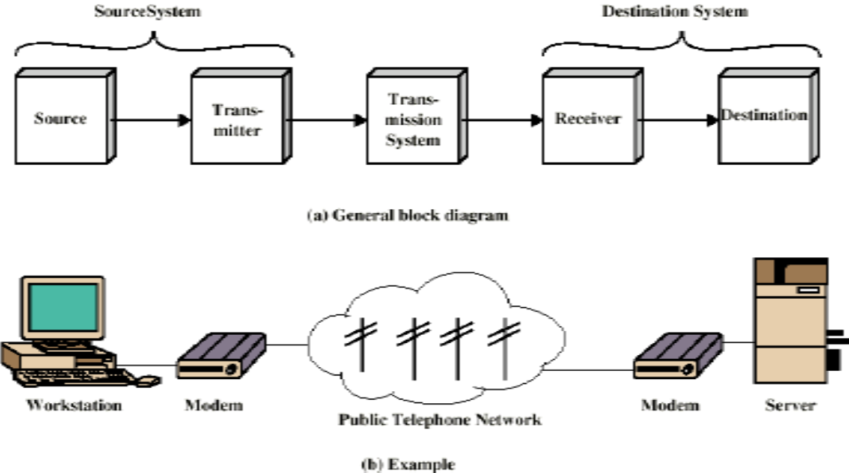
Communication Model

Slide 25
Parts of Communication Model
Source
Generates data to be transmitted
Telephone, Mic, Computer, Web Cam, Scanner, Digital Camera
Transmitter
Data produced can not be transmitted directly
Data should be converted to signals
Transmitter converts data into transmittable signals
Modem converts Data Bits into Signals
Modulation

Slide 26
Parts of Communication Model
Transmission System
It carries data from one party (sender) to another (receiver)
Can be Wired / Wireless medium
Can be complex network like Internet
Receiver
It receives signal
Converts received signal into data (bits)
Modem (demodulation)
Destination
Takes incoming data from receiver.

Slide 27
Protocols
Set of rules that drives the packets across the internet.
Examples:
IP
TCP
UDP
SMTP
HTTP
A protocol defines the format and the order of messages exchanged between two or more communicating entities, as well as the actions taken on the transmission and/or receipt of a message or other event.
Notes:
Given the importance of protocols to the Internet, it’s important that everyone
agree on what each and every protocol does, so that people can create systems and
products that interoperate. This is where standards come into play. Internet standards
are developed by the Internet Engineering Task Force (IETF)[IETF 2012].
The IETF standards documents are called requests for comments (RFCs). RFCs
started out as general requests for comments (hence the name) to resolve network
and protocol design problems that faced the precursor to the Internet [Allman 2011].
RFCs tend to be quite technical and detailed. They define protocols such as TCP, IP,
HTTP (for the Web), and SMTP (for e-mail). There are currently more than 6,000
RFCs. Other bodies also specify standards for network components, most notably
for network links. The IEEE 802 LAN/MAN Standards Committee [IEEE 802
2012], for example, specifies the Ethernet and wireless WiFi standards.

Slide 28
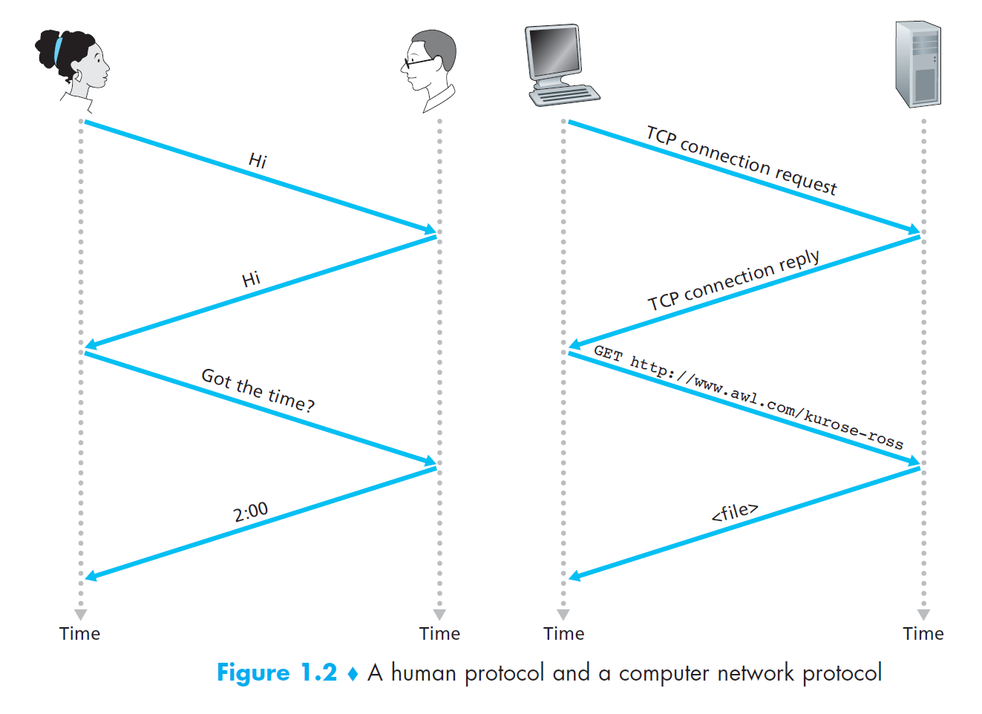

Slide 29
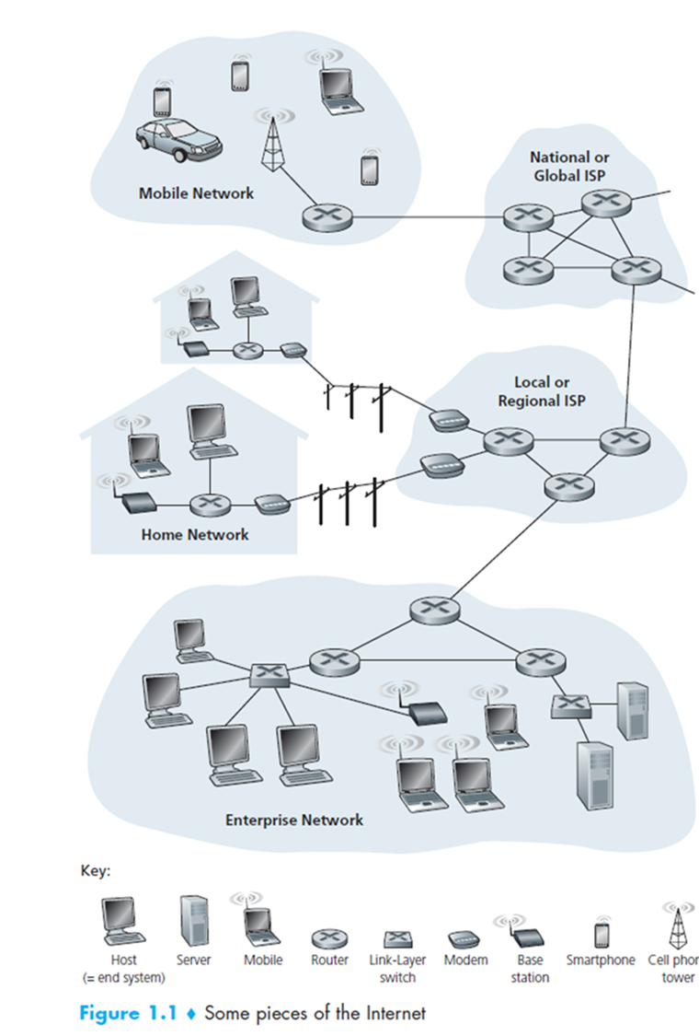

Slide 30
Services
Internet is an infrastructure that provides services to applications
Examples:
electronic mail, Web surfing, social networks, instant messaging, Voiceover-IP (VoIP), video streaming, distributed games, peer-to-peer (P2P) file sharing, television over the Internet, remote login, and much, much more.
Called distributed applications, since they involve multiple end systems that exchange data with each other.
Applications run on the end systems and not on the switches.
Application Programming Interface APIs

Slide 31
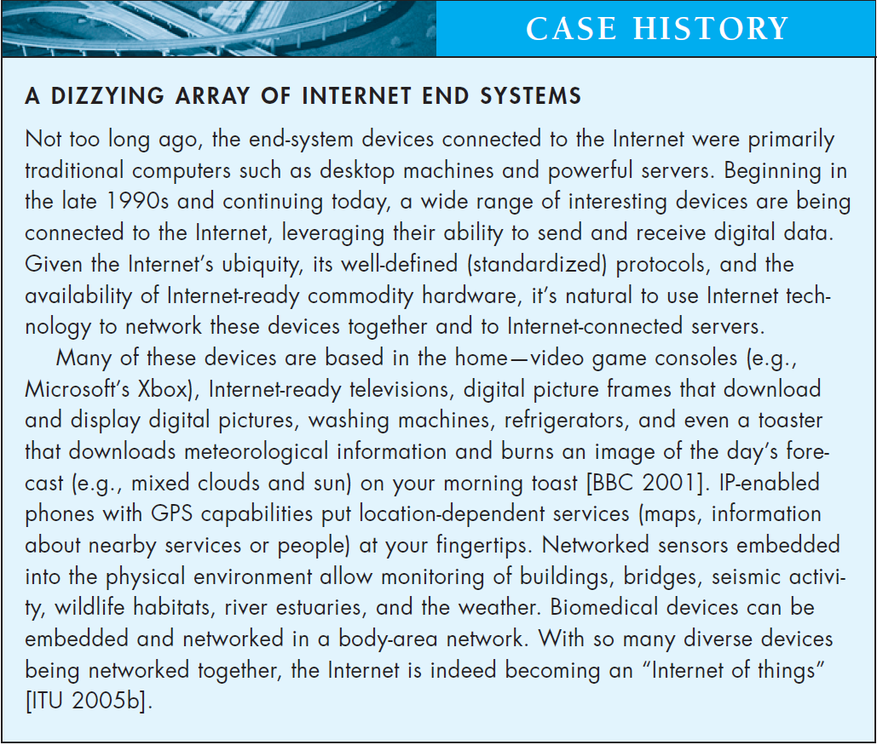

Slide 32
Network Edge
Hosts/ End Nodes
Client-Servers/ Peers
Access Network
the network that physically connects an end system to the first router (also known as the “edge router”) on a path from the end system to any other distant end system.
Notes:
Most common Home networks are DSL Digital Subscriber line and cable.
On corporate and university campuses, and increasingly in home settings, a local area
network (LAN) is used to connect an end system to the edge router. Although there
are many types of LAN technologies, Ethernet is by far the most prevalent access
technology in corporate, university, and home networks.

Slide 33
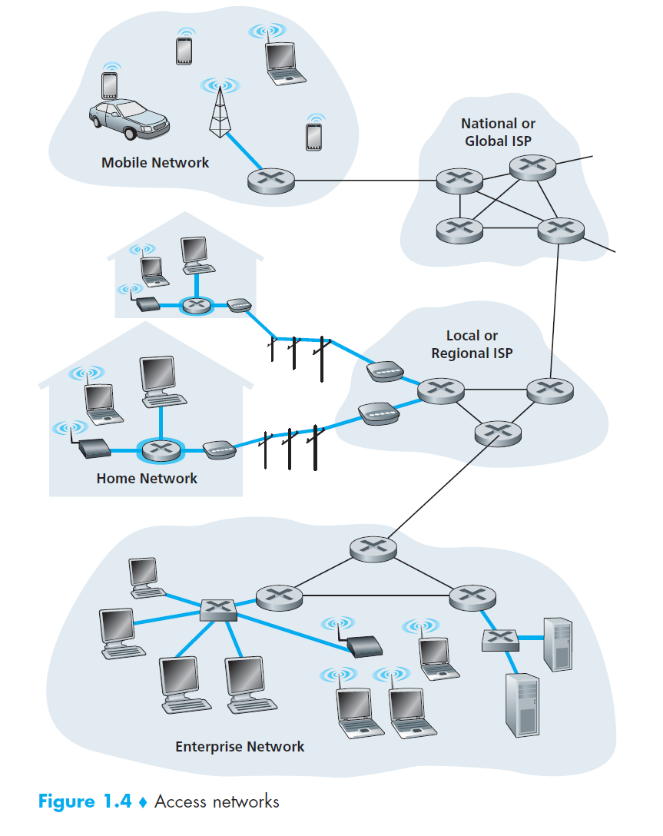
Notes:
LAN, WAN

Slide 34
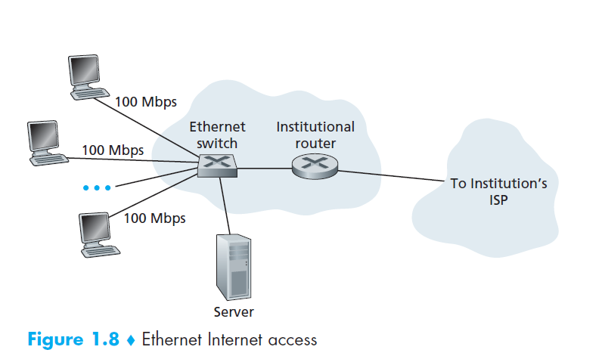

Slide 35
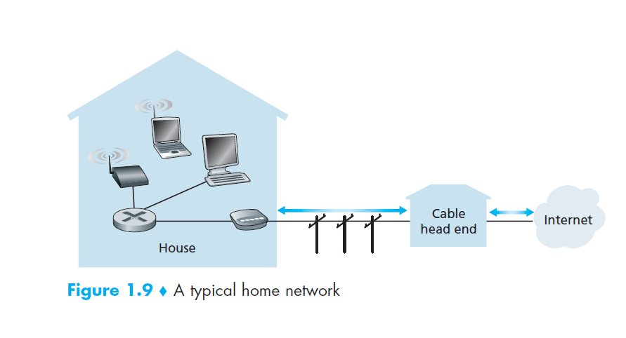

Slide 36
Wide-Area Wireless Access
Mobile Networks
3G, 4G, 5G, LTE
Notes:
LTE ( for “Long-Term Evolution”—a candidate for Bad
Acronym of the Year Award) has its roots in 3G technology, and can potentially
achieve rates in excess of 10 Mbps. LTE

Slide 38
References
https://www.computernetworkingnotes.com/networking-tutorials/network-cable-types-and-specifications.html

